Slide 1
CS 4530: Fundamentals of Software Engineering
Module 06: React Hook Patterns
Adeel Bhutta and Mitch Wand
Khoury College of Computer Sciences
© 2026 Released under the CC BY-SA license
Notes:
Welcome to Module06: React Hooks. Hooks are a unique feature of REACT, which enable React components to deal with inputs other than mouse clicks and the like.

Slide 2
Learning Objectives for this Module
By the end of this module, you should be able to:
  Explain the basic use cases for useEffect
  Explain when a useEffect is executed, and when its return value is executed
  Construct simple custom hooks and explain why they are useful.
  Be able to explain the three core steps of a test (assemble, act, assess) can map to UI component testing
Notes:
<read slide>

Slide 3
Lesson 6.1 useEffect
Notes:
David Khourshid (Microsoft developer) said that perhaps ‘useEffect’ should have been called ‘useSynchronize’

Slide 4
useEffect is a mechanism for synchronizing a component with an external system
export default function ClockDisplay(props: ClockDisplayProps) {
const clock = props.clock;
const [localTime, setLocalTime] = useState(0);
useEffect(() => {
const listener1 = () => setLocalTime(time => time +1)
clock.addListener(listener1);
return () => {clock.removeListener(listener1);
};
}, []);
Action to take on first render
Action to take when component dismounts
src/Shared/Components/SimpleClockDisplay.tsx
Empty array says: do this on first render only
https://react.dev/reference/react/useEffect
Notes:
The fundamental job of useEffect is to coordinate your component with some system external to REACT. Here’s an example, where we want to connect to an external clock (passed as a prop). Let's look at the different pieces of the useEffect. We’ll see later how to build a clock display around this example
<click>
First is the dependency array. This controls when the useEffect is executed. Here we've put in an empty array, which specifies that this useEffect is to be run on the first render only. There are other possibilities, which we'll talk about later.
<click>
Next is the hook function. This is the function that is run when the useEffect is executed-- in this case, on the first render. Here, we create a connection to the external clock.
<click>
Last is the cleanup function. In the useEffect design, this is the value returned by the hook function-- look at the 'return'. Because this hook is run only when the component mounts, the cleanup function is run only when the component dismounts. In this case, the cleanup function releases the connection to the external clock. This is the polite thing to do, as it eliminates possible resource leaks. We'll talk about other possibilities later.
Did you notice that this example is unrealistic? Why do you think so? <Ans: no way for the rest of the component to refer to the connection>. We'll study a working example in a minute.

Slide 5
An external system means any piece of code that’s not inside your React component
An event in the lifecycle of a component, like redisplay.
A timer managed with setInterval and clearInterval
An event subscription like a chat server (sockets?)
A call to fetch data from an external API or web site
An external animation library
A piece of business logic in an app that is external to your component
Notes:
What do we mean by an "external system"? <read slide>

Slide 6
Let’s build a clock display
src/Shared/types.ts
Start by defining the props
export interface ClockDisplayProps {
name: string;
key: number;
clock: ITicker;
handleDelete?: () => void;
handleAdd?: () => void;
noisyDelete?: boolean;
}
Notes:
Props play the role of types in the React system, so good design tells us we should start with those.
We use ‘Iticker’ rather than Iclock as the interface for our clock, since our intention is that it should invoke its listeners at some regular interval; it doesn’t actually keep track of the time, number of clicks, etc.
Our intention is to use this component both for displaying a single clock or an array of clocks. We’ll need the last three props for a set of clock displays, but not for a displaying a single clock. The presence of those props will tell us which kind of app we are building.

Slide 7
<ClockDisplay> (1): set up the useEffect
src/Shared/Components/SimpleClockDisplay.tsx
import { useState, useEffect } from "react";
import { Box, Button, HStack, VStack } from "@chakra-ui/react";
import type { ClockDisplayProps } from "../types";
// this version simply imports a clock from its parent
export default function ClockDisplay(props: ClockDisplayProps) {
const clock = props.clock;
const [localTime, setLocalTime] = useState(0);
useEffect(() => {
const listener1 = () => {setLocalTime((localTime) => localTime + 1)};
clock.addListener(listener1);
return () => {
clock.removeListener(listener1);
};
}, []);
Notes:
First we import the dependencies and set up the useEffect

Slide 8
<ClockDisplay> (2): the handlers
function handleStart() { clock.start(); }
function handleStop() { clock.stop(); }
function handleReset() { setLocalTime(0); }
Notes:
The handlers simply transmit signals to the clock

Slide 9
<ClockDisplay> (3): the display logic
return (
<VStack border="2px" borderColor="green" padding="1" width="fit-content" mx="auto">
<HStack>
<Box>Clock: {props.name}</Box>
<Box>Time = {localTime}</Box>
<Box>nlisteners = {clock.nListeners}</Box>
</HStack>
<HStack>
<Button onClick={handleStart}>Start</Button>
<Button onClick={handleStop}>Stop</Button>
<Button onClick={handleReset}>Reset</Button>
</HStack>
{props.handleAdd && (
<HStack>
<Button onClick={props.handleDelete}>Delete {props.name}</Button>
<Button onClick={props.handleAdd}>Add a clock</Button>
</HStack>
)}
</VStack>
);
Notes:
Notice the props.handleAdd && idiom: the Hstack is displayed only when props.handleAdd is defined.

Slide 10
Running a single clock
import { useState, useEffect } from "react";
import { type ITicker } from "../../Shared/types";
import Ticker from '../../Shared/Classes/Ticker'
import ClockDisplay from "../../Shared/Components/SimpleClockDisplay";
export default function App() {
const [clock, _] = useState<ITicker>(new Ticker(1000));
return (
<ClockDisplay name="demo1" key={1} clock={clock} />
)
}

Slide 11
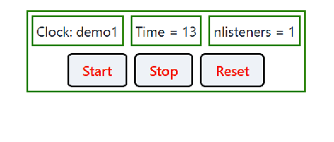
Demo!
Notes:
We opened a shell window, and said “npm run dev”. Then a browser window popped up, showing this…
<DEMO start, stop, reset>

Slide 12
We can use ClockDisplay with a different parent!
src/Examples/ThreeClocks/App.tsx
Components are modular, so we can use ClockDisplay with a different parent.
But this required careful design!
export default function App() {
const [clock, _] = useState<ITicker>(new Ticker(1000));
return (
<VStack>
<Heading>Three Clocks</Heading>
<ClockDisplay key={1} name="Clock A" clock={clock} />
<ClockDisplay key={2} name="Clock B" clock={clock} />
<ClockDisplay key={3} name="Clock C" clock={clock} />
</VStack>
);
}

Slide 13
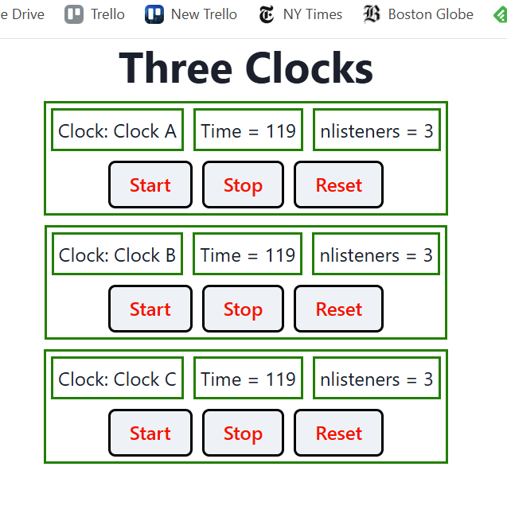
running ThreeClocks
Next: back to useEffect in detail….
Notes:
<DEMO>
Demo start, stop, reset. Observe that the clocks always show the same time (as they should, since they share the same clock underneath(!)
{Puzzle: what’s the simplest way to modify this so that the clocks are independent?)

Slide 14
useEffect’s Dependencies Control Its Execution
useEffect takes an optional array of dependencies
The effect is only executed if one or more of the values in the dependency change (e.g. by a setter)
Special Cases:
  [] means run only on first render
  No argument means run on every render
Notes:
Up to now, we’ve only dealt with one kind of useEffect– one that’s run only when the component is first constructed. But there are others.

Slide 15
Example (Part 1)
src/Examples/useEffect-demo.tsx
export default function App() {
const [i, setI] = useState(0);
const [j, setJ] = useState(0);
// runs only on first render.
useEffect(() => {
console.log('useEffect #1 is run only on first render');
}, []);
useEffect(() => {
console.log('useEffect #2I is run when i changes');
}, [i]);
useEffect(() => {
console.log('useEffect #2J is run when j changes');
}, [j]);
useEffect(() => {
console.log('useEffect #2IJ is run when either i or j changes');
}, [i,j]);
// runs on every render
useEffect(() => {
console.log('useEffect #3 is called on every render');
});
function onClickI() {
console.log('Clicked i!');
setI(lastI => lastI+1);
// bound variable name doesn't matter, of course
// setI(i+1) is a bug, because value of i may not
// be current.
}
function onClickJ() {
console.log('Clicked j!');
setJ(j => j+1);
}
return (
<VStack>
<Heading>useEffect demo #1IJ</Heading>
<Text> i is {i} </Text>
<Button onClick={onClickI}>Increment i</Button>
<Text> j is {j} </Text>
<Button onClick={onClickJ}>Increment j</Button>
</VStack>
);
Notes:
Here's an example with two state variables, I and j, and a bunch of useEffects, with different dependency arrays. The log messages tell us when each of the useEffects run:
useEffect #1 has an empty dependency array, so it is run only on first render
useEffect #2I has a dependency array with just i, so it is run only when n changes.
useEffect #2J has a dependency array with just j, so it is run only when m changes.
useEffects #3 has no second argument, so it is run on every render.
We'll see that all these effects are run in the order they appear in the file.
NOTE: when you load the component, these hooks may run twice in development mode (npm run dev), but they will only run once on subsequent redisplays, and (most importantly) in production.

Slide 16
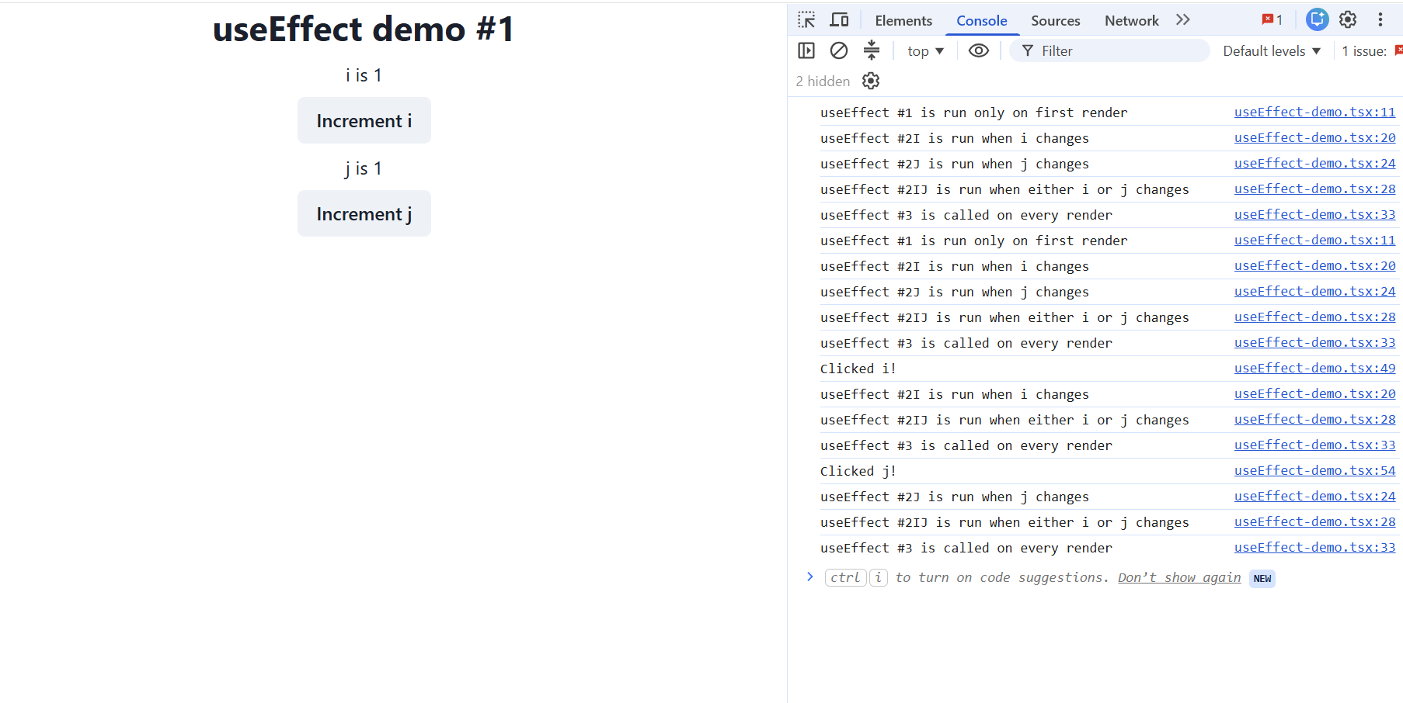
Demo
Open the console by pressing F12 (on Windows) or Cmd-Option-J (on Mac)
Notes:
<explain slide, or demo & explain as you go> Open the console by saying F12 (on Windows) or Cmd-Option-J (on Mac)

Slide 17
When is the cleanup function executed?
In general, the cleanup function is executed sometime before the next time the hook is run.
For the first-time-only case, this means when the component is dismounted.
Let's look at useEffect demo again, this time with noisy cleanups.
Notes:
<Read slide>
<Demo: Apps/ArrayOfClocksApp.tsx >
Observe that the number of listeners is decremented whenever you delete a clock display.
This tells us that the cleanup code is running. And you can watch this in the console log also.
Let's look at the code for this:

Slide 18
Demo
src/Examples/useEffectsDemos/useEffect-demoWithCleanUps.tsx
function cleanup(message: string) {
return () => {
console.log('cleanup: ' + message);
};
}
export default function App() {
const [i, setI] = useState(0);
const [j, setJ] = useState(0);
// runs only on first render.
useEffect(() => {
console.log('useEffect #1 is run only on first render');
return cleanup('useEffect #1');
}, []);
useEffect(() => {
console.log('useEffect #2I is run when i changes');
return cleanup('useEffect #2I');
}, [i]);
// etc.
Notes:
Here we've taken our useEffect demo and instrumented it to make the execution of the cleanup functions visible.
To do this, we've defined a function `cleanup` that takes a string and returns a 0-argument function that is suitable to use as a return value from useEffect.
Then we've taken each useEffect and modified it to return a suitably labelled cleanup function.
Last, we've modified the "Increment n" and "Increment m" buttons to log a message to the console when they are clicked (not shown on slide).
Let's watch this in action

Slide 19
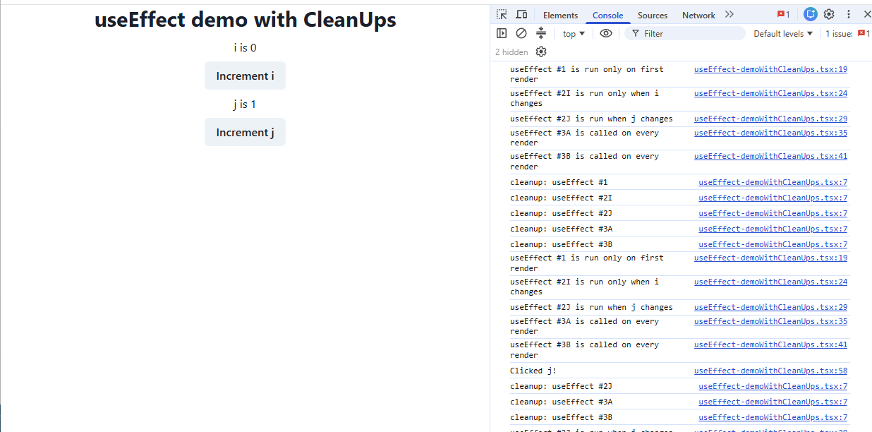
Demo
Notes:
Here we've hit Reload. Observe that effects #1, 2J, 3A, and 3B are run.
Then we clicked ‘J'.
We will need to run 2J, 3A, and 3B again. So first, the cleanups for 2J, 3A, and 3B are run, and then 2J, 3A, and 3B are run.
(As we said, the cleanups are guaranteed to be run before the next execution of the useEffect).
What about useEffect #1, which is only run on the first render? We could create an example that would demonstrate that, but it would take more effort to create and explain than it would be worth ☺

Slide 20
Communication with an (Actual) External System
In the previous example, everything was present in the one codebase, including the clock.
More common situation is that the user interface components need to communicate with a remote system, not necessarily in the same codebase.

Slide 21
Example: Interacting With a REST-based Server
Doing this in the real world is somewhat more complicated than this (see Resources for details)
export default function RandomNASA() {
const [image, setImage] = useState<null | string>(null);
const [error, setError] = useState<unknown>(null);
useEffect(() => {
fetch("https://api.nasa.gov/planetary/apod?api_key=DEMO_KEY")
.then((response) => response.json())
.then((json) => {
const data = z.object({ url: z.string() }).parse(json);
setImage(data.url);
})
.catch((err) => setError(err));
}, []);
return error !== null ? (
`Could not retrieve image: ${error}`
) : image !== null ? (
<img src={image} />
) : (
`Loading...`
);
}
This function runs after the fetch returns
And this function runs after that
This function runs if there’s an error in the previous
Notes:
Often, we want to use code inside of an effect that calls a REST endpoint. Calls to rest endpoints can happen with the `fetch` function built in to browsers, or with a library like `axios` that the project code uses, but in either case the call returns a promise. A promise doesn’t directly give you the result the function call, but it returns an object with a `then` method: it promises to call this function later, after the server responds to the API request.
(We’ll talk much more about promises in a few weeks.)
This React function will show “Loading” until the API request succeeds, and then it will show the random image from the NASA random image-of-the-day API.

Slide 22
Lesson 6.2 Custom Hooks

Slide 23
Custom Hooks
REACT lets us combine useState and useEffect to build custom hooks.
Custom Hooks let us separate business logic from display logic
Notes:
<Read slide>

Slide 24
Example: useClock
Src/Shared/Hooks/useClock.ts
import { useEffect } from "react";
import Ticker from "../Classes/Ticker";
import { type ITicker } from "../types";
// takes a listener function as an argument
// returns the clock object
export function useClock(listener1: () => void): ITicker {
const clock = new Ticker(1000);
useEffect(() => {
clock.addListener(listener1);
return () => {
clock.removeListener(listener1);
};
}, []);
return clock;
}

Slide 25
Using useClock
src/Examples/SimpleClockDisplayWithUseClock.tsx
import { useState } from "react";
import { type ClockDisplayProps } from "../Shared/types";
import { type ITicker } from "../Shared/types";
import { useClock } from "../Shared/Hooks/useClock";
import { Box, HStack, IconButton } from "@chakra-ui/react";
import { AiOutlineDelete, AiOutlinePlus } from "react-icons/ai";
export function ClockDisplay(props: ClockDisplayProps) {
const [localTime, setLocalTime] = useState(0);
const incrementLocalTime = () => setLocalTime((localTime) => localTime + 1);
const clock: ITicker = useClock(incrementLocalTime);
return (
<HStack>
<Box>Clock: {props.name}</Box>
<Box>Time = {localTime}</Box>
<Box>nlisteners = {clock.nListeners}</Box>
<IconButton aria-label={"delete"} onClick={props.handleDelete} icon={<AiOutlineDelete />} />
<IconButton aria-label={"add"} onClick={props.handleAdd} icon={<AiOutlinePlus />} />
</HStack>
);
}
Notes:
Here’s our old friend ClockDisplay, but this time using useClock. We take advantage of the fact that useClock returns the clock so that we can refer to clock.nListeners, (or start and stop the clock, if that affordance is available) from the client.
/** this para only applies if we get starting and stopping working
Note that if we have several components (as in ArrayOfClocksApp), stopping or starting the clock in one component will start or stop it in all of them.
*/
More complicated hooks might return more complicated objects. For example, covey.town makes extensive use of a hook called useTown that returns the town in which some component is running.

Slide 26
Example: ToDoList
src/Apps/ToDoApp/App.tsx
export default function ToDoApp () {
const [todoList,setTodolist] = useState<ToDoItem[]>([])
const [itemKey,setItemKey] = useState<number>(0) // first unused key
function handleAdd (title:string, priority:string) {
if (title === '') {return} // ignore blank button presses
setTodolist(todoList.concat({title: title, priority: priority, key: itemKey}))
setItemKey(itemKey + 1)
}
function handleDelete(targetKey:number) {
const newList = todoList.filter(item => item.key !== targetKey)
setTodolist(newList)
}
return (
<VStack>
<Heading>TODO List</Heading>
<ToDoItemEntryForm onAdd={handleAdd}/>
<ToDoListDisplay items={todoList} onDelete={handleDelete}/>
</VStack>
)
}
business logic
display logic

Slide 27
Refactoring ToDoList
src/Apps/ToDoAppWithCustomHooks/App.tsx
business logic is encapsulated
export default function ToDoApp () {
const {todoList, handleAdd, handleDelete} = useToDoItemList()
return (
<VStack>
<Heading>TODO List</Heading>
<ToDoItemEntryForm onAdd={handleAdd}/>
<ToDoListDisplay items={todoList} onDelete={handleDelete}/>
</VStack>
)
}

Slide 28
The hook encapsulates the business logic
src/Apps/ToDoAppWithCustomHooks/useToDoItemList.tsx
export default function useToDoItemList () {
const [todoList,setTodolist] = useState<ToDoItem[]>([])
const [itemKey,setItemKey] = useState<number>(0) // first unused key
function handleAdd (title:string, priority:string) {
if (title === '') {return} // ignore blank button presses
setTodolist(todoList.concat({title: title, priority: priority, key: itemKey}))
setItemKey(itemKey + 1)
}
function handleDelete(targetKey:number) {
const newList = todoList.filter(item => item.key !== targetKey)
setTodolist(newList)
}
return {todoList: todoList, handleAdd: handleAdd, handleDelete: handleDelete}
}
Notes:
The business logic typically consist of the basic hooks (useState and useDisplay), and the handlers that handle signals from the display (recall how we wrote ClockDisplay back in slides 7-9)

Slide 29
The hook is like a class managing a piece of state
export default function useToDoItemList () {
const [todoList,setTodolist] = useState<ToDoItem[]>([])
const [itemKey,setItemKey] = useState<number>(0) // first unused key
function handleAdd (title:string, priority:string) {
if (title === '') {return} // ignore blank button presses
setTodolist(todoList.concat({title: title, priority: priority, key: itemKey}))
setItemKey(itemKey + 1)
}
function handleDelete(targetKey:number) {
const newList = todoList.filter(item => item.key !== targetKey)
setTodolist(newList)
}
return {todoList: todoList, handleAdd: handleAdd, handleDelete: handleDelete}
}
handleAdd and handleDelete are the only methods for manipulating the state

Slide 30
The hook's state becomes part of its user's state.
export default function useToDoItemList () {
const [todoList,setTodolist] = useState<ToDoItem[]>([])
const [itemKey,setItemKey] = useState<number>(0) // first unused key
function handleAdd (title:string, priority:string) {
if (title === '') {return} // ignore blank button presses
setTodolist(todoList.concat({title: title, priority: priority, key: itemKey}))
setItemKey(itemKey + 1)
}
function handleDelete(targetKey:number) {
const newList = todoList.filter(item => item.key !== targetKey)
setTodolist(newList)
}
return {todoList: todoList, handleAdd: handleAdd, handleDelete: handleDelete}
}
calling these setters redisplays the whole component

Slide 31
The Rules of Hooks
Only call hooks at the top level
  Not within loops, inside conditions, or nested functions
  Rationale: The order of hooks called must always be the same each time a component renders
Only call hooks from React Components or Custom Hooks
  Not from any other helper methods or classes
  Rationale: React must know the component that the call to the hook is associated with
export function LikeButton(){
const [isLiked, setIsLiked] = useState(false);
const [count, setCount] = useState(0);
...
}
React knows which useState is which by tracking calls to them from components in the render tree
Notes:
There are two rules of hooks, both of which are necessary for React to uniquely identify calls to hooks across different renders of the same component.
(Read slide)

Slide 32
We Use Two ESLint Rules for React Hooks
You should not violate the rules of hooks. These linter plugins help detect violations
React-hooks/rules-of-hooks
  Enforces that hooks are only called from React functional components or custom hooks
React-hooks/exhaustive-deps
  Enforces that all variables used in useEffects are included as dependencies
Notes:
That is the end of Module 8, Part 1. In Part 2, we'll talk about how one could use automated testing on components of React and similar systems.

Slide 33
Putting it All Together
In the previous examples, we learned
  how to introduce side effects
  how to create our own hooks
We can use these concepts to make React components interact with a remote system (e.g., REST services).

Slide 34
Example: Setting Up and Cleaning Up a Chat Subscription; Showing Unread Messages
useEffect(() => {
const socket = new WebSocket('wss://api.randomsite.com/chat');
socket.onmessage = (event) => {
const message = JSON.parse(event.data);
setMessages((prev) => [...prev, message]);
};
return () => {
socket.close();
};
}, []);
This allows you to subscribe to live chat messages
This function runs at cleanup to avoid memory leaks
This updates the browser tab title to show the number of unread messages or notifications
useEffect(() => {
document.title = `You have ${unreadMsgs} unread messages`;
}, [unreadMsgs]);
Notes:
<read slide>

Slide 35
Interacting With a REST-based Server
useEffect(() => {
/**
* Function to fetch the question data based on the question ID.
*/
const fetchData = async () => {
try {
const res = await getQuestionById(questionID, user.username);
setQuestion(res || null);
} catch (error) {
console.error('Error fetching question:', error);
}
};
fetchData().catch(e => console.log(e));
}, [questionID, user.username]);
Async call to REST service
Run effect only when questionID and username changes
Notes:
The effect is inside the custom hook. It makes a call to a async function that connects to the REST service.
The effect does not run on every render, but only when the variables in the dependency array change.
Notice the catch block with fetchData(). Ask why is it written that way?
- because fetchData() returns a promise.

Slide 36
Interacting With a REST-based Server
/**
* Function to get a question by its ID.
*
* @param qid - The ID of the question to retrieve.
* @param username - The username of the user requesting the question.
* @throws Error if there is an issue fetching the question by ID.
*/
const getQuestionById = async (
qid: string,
username: string,
): Promise<PopulatedDatabaseQuestion> => {
const res = await api.get(`${QUESTION_API_URL}/getQuestionById/${qid}?username=${username}`);
if (res.status !== 200) {
throw new Error('Error when fetching question by id’);
}
return res.data;
};
Notes:
This is the function that actually calls the REST API
This is the same function that was called from the useEffect in the custom hook

Slide 37
Interacting With a REST-based Server
/**
* AnswerPage component that displays the full content of a question along with its answers.
* It also includes the functionality to vote, ask a new question, and post a new answer.
*/
const AnswerPage = () => {
const { questionID, question, handleNewComment, handleNewAnswer } = useAnswerPage();
if (!question) {
return null;
}
return (
<>
<VoteComponent question={question} />
<AnswerHeader ansCount={question.answers.length} title={question.title} />
Custom hook being used.
Notes:
- The example shows a snippet from the component that uses the custom hook.
- The custom hook defines the effect that calls the REST service for answers.

Slide 38
There are several other React Hooks that might be useful.
React Context allows you to share state between deeply nested components more easily
useRef Hook lets you reference a value that’s not needed for rendering
useEffectEvent Hook lets you extract non-reactive logic from your Effects into a reusable function.
import { useContext } from ‘react';
function myButtonComponent() {
const theme = useContext(ThemeContext);
// ...
}
https://react.dev/reference/react/useContext
Notes:
<read slide>

Slide 39
Lesson 6.3 Testing your React components

Slide 40
Testing React components
The AAA pattern ("Assemble/Act/Assess") still applies
Need a test double for the React system
  render components into a "virtual dom" or into a captive web browser
We'll be using a package called "Playwright" to do this.
Notes:
We can test React components by building a test double for the react system. The test double render scomponents into a "virtual dom" just like the browser's DOM. We can interact with the test by firing events just like a user would, and then we should be able to inspect the virtual DOM to see what happened.
This can all be done using a package called "testing-library", which is compatible not only with React and Jest, but with many UI libraries and testing frameworks.

Slide 41
Recall: Most tests are in AAA form: Assemble/Act/Assess
test('addStudent should add a student to the database', () => {
// const db = new DataBase ()
expect(db.nameToIDs('blair')).toEqual([])
const id1 = db.addStudent('blair’);
expect(db.nameToIDs('blair')).toEqual([id1])
});
Assemble (and check that you’ve assembled it correctly)
Act (do the action that you are trying to test)
Assess: check to see that the response is correct
Notes:
Remember this example from Module 3: <review text if needed>
In order to run a test, we need to first ASSEMBLE it. This may include creating instances of classes/variables, setting up test data for inputs, etc. We should always check to see that we’ve set it up correctly. In this example most of the work has already been done in a beforeEach block (not shown here)
Then we ACT: we do the action under test.
Last, we ASSESS: we check to see that the response was acceptable. In Jest, this is done by the expect function; in other testing frameworks this is called assert. Note that the test uses some methods other than the one we’re testing; we’ll write tests for nameToIDs separately.
Another way of looking at this is that this test is not just about addStudent; it’s making sure that addStudent and nameToIDs cooperate (or conspire) together to produce the desired behavior.

Slide 42
Playwright commands work on a ”page object”
.goto() | Navigate to a URL. Many tests begin with this command.
.getByLabel() | Find form elements by their associated label text.
.getByRole() | Find elements by their ARIA role(button, textbox, etc) .
.getByText() | Find elements by their text content.
.waitForURL() | Wait for navigation to complete to a specific URL.
.fill() | Type text into an input field.
These will fail if the specified element does not exist
https://playwright.dev/docs/locators

Slide 43
A typical playwright test
test('should allow an existing user to log in', async ({ page }) => {
await page.goto('/login');
await page.getByLabel('Username’)
.fill("Frau Drei");
await page.getByLabel('Password’,
{ exact: true }).fill(password);
await page.getByRole('button’,
{ name: 'Log In' }).click();
await page.waitForURL('/');
await expect(page.getByText
('signed in as Frau Drei')).toBeVisible();
});
Assemble (navigate to the page)
Act (fill form and click login)
Assess: check to see that the response is correct

Slide 44
Learning Objectives for this Lesson
By the end of this lesson, you should be able to:
  Explain the basic use cases for useEffect
  Explain when a useEffect is executed, and when its return value is executed
  Construct simple custom hooks and explain why they are useful.
  Be able to explain the three core steps of a test (assemble, act, assess) can map to UI component testing

